Slide 1

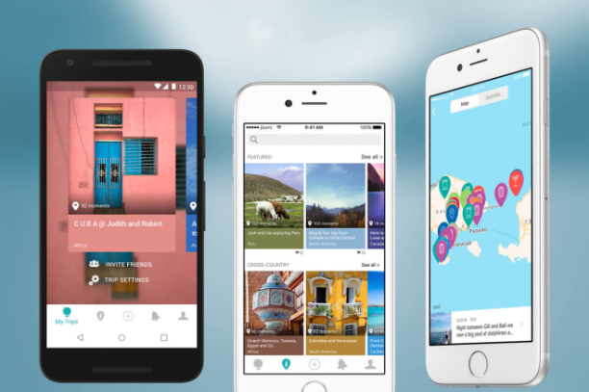


MEMORI
What is Memori?
Memori is a travel journal app designed to keep your treasured memories safe. You’ll no longer store everything about your holiday in several places.
Memori can keep all of your holiday memories in a safe and in a reliable place, which you can access anywhere in the world. It could even tell you what to visit next on your journey.
Memori uses a simple and easy to use UI with a whole list of features. A new coveted feature found in apps called Dark Mode. A whole new way to share your adventurous holidays through a social media service where users can view others’ holidays.
What can Memori do?
What makes Memori better thank its rivals?
IMAGE?
BY BHAVEN PATEL
Many of the current alternatives do not provide such a wide array of services, which is why I believe this app will be the first of its kind. Memori will revolutionize the way holidays are kept and shared!
Why choose Memori?
Notes:
Image References:
Travel Image: https://disabilityhorizons.com/2017/06/all-clear-travel-insurance-2/
App Image: https://techcrunch.com/2016/08/23/journi/
Cloud Image: https://www.emhtechnology.com/the-business-benefits-of-cloud-storage/
Dark/Light Mode Image: Self-Designed

